Slide 1
IT457
Cloud Computing
Week3_Lec1-IP Addressing

Slide 2

IP addressing: introduction
223.1.1.1
IP address: 32-bit identifier associated with each host or router interface
interface: connection between host/router and physical link
  router’s typically have multiple interfaces
  host typically has one or two interfaces (e.g., wired Ethernet, wireless 802.11)
223.1.2.1
223.1.1.2
223.1.1.4
223.1.2.9
223.1.1.3
223.1.3.27
223.1.2.2
223.1.3.1
223.1.3.2
dotted-decimal IP address notation:
223.1.1.1 = 11011111 00000001 00000001 00000001
223
1
1
1

Slide 3
IP addresses: how to get one?
That’s actually two questions:
Q: How does a host get IP address within its network (host part of address)?
Q: How does a network get IP address for itself (network part of address)
How does host get IP address?
hard-coded by sysadmin in config file (e.g., /etc/rc.config in UNIX)
DHCP: Dynamic Host Configuration Protocol: dynamically get address from as server
  “plug-and-play”

Slide 4
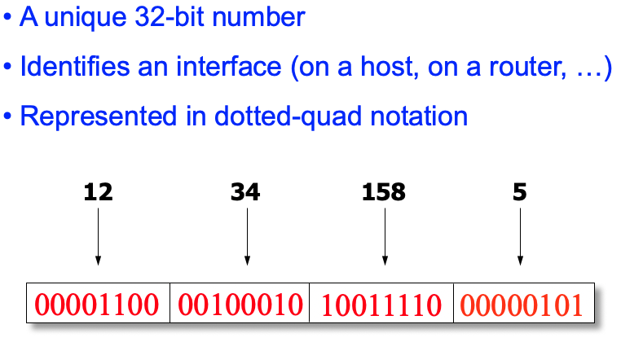

Slide 5
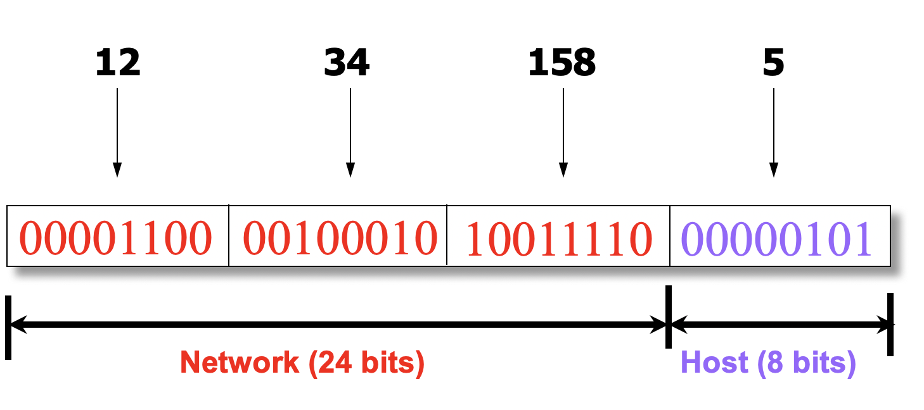
Hierarchical Addressing
Addressing in the Indian mail sys
  Zip code: 382007
  Street: Indroda circle
  Building on street: DAIICT
  Room in building: 21**
  Name of occupant: ABC
Forwarding the mail
  Deliver letter to the post office in the zip code
  Assign letter to mailman covering the street
  Drop letter into mailbox for the building/room
  Give letter to the appropriate person
Divided into network & host portions (left and right)
12.34.158.0/24 is a 24-bit prefix with 2⁸ addresses

Slide 6
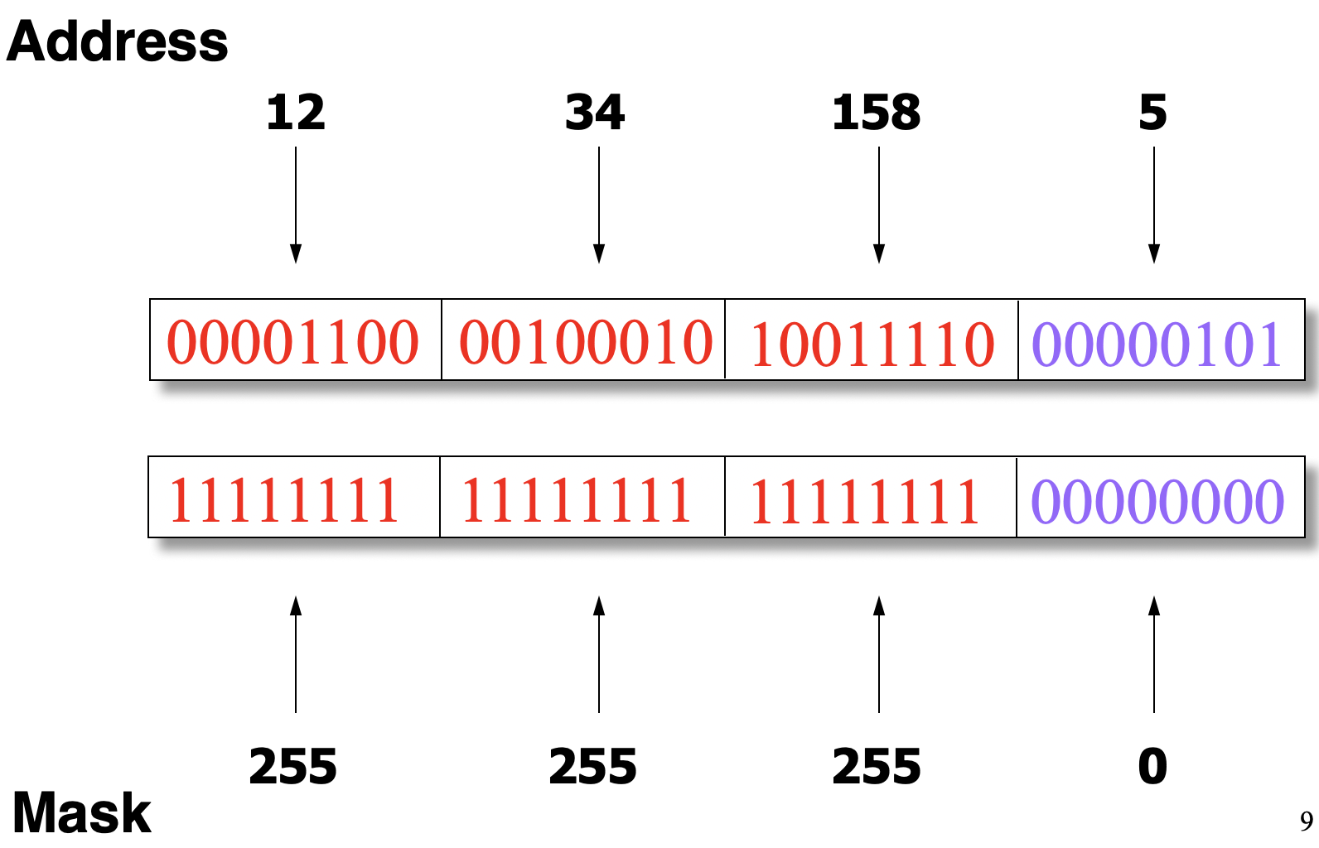
IP Address and a 24-bit Subnet Mask

Slide 7
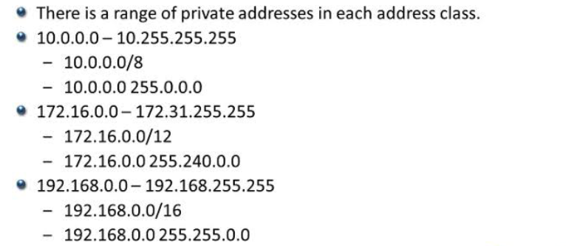
Classful Addressing
In the olden days, only fixed allocation sizes
  Class A: 0*
    Very large /8 blocks
  Class B: 10*
    Large /16 blocks
  Class C: 110*
    Small /24 blocks
  Class D: 1110*
    Multicast groups
  Class E: 11110*
    Reserved for future use

Slide 8
Subnets
223.1.1.1
What’s a subnet ?
  device interfaces that can physically reach each other without passing through an intervening router
  detach each interface from its host or router, creating “islands” of isolated network
  each isolated network is called a subnet
223.1.2.1
223.1.1.2
223.1.1.4
223.1.2.9
223.1.1.3
223.1.3.27
223.1.2.2
IP addresses have structure:
  subnet part: devices in same subnet have common high order bits
  host part: remaining low order bits
223.1.3.1
223.1.3.2
network consisting of 3 subnets

Slide 9
IP addresses and their usage in Cloud
Class Block | Subnet Mask | CIDR Block | Usable IPs | Cloud Context
10.0.0.0 – 10.255.255.255 | 255.0.0.0 | 10.0.0.0/8 | ~16.7 Million | Standard choice for enterprise-wide multi-region VPC/VNet address spaces.
172.16.0.0 – 172.31.255.255 | 255.240.0.0 | 172.16.0.0/12 | ~1 Million | Popular default range for Docker, Kubernetes, and regional VPC networks.
192.168.0.0 – 192.168.255.255 | 255.255.0.0 | 192.168.0.0/16 | ~65,536 | Small branch networks or individual subnets.

Slide 10
NAT: network address translation
  all devices in local network have 32-bit addresses in a “private” IP address space (10/8, 172.16/12, 192.168/16 prefixes) that can only be used in local network
  advantages:
    just one IP address needed from provider ISP for all devices
    can change addresses of host in local network without notifying outside world
    can change ISP without changing addresses of devices in local network
    security: devices inside local net not directly addressable, visible by outside world

Slide 11
NAT: network address translation
implementation: NAT router must (transparently):
  outgoing datagrams: replace (source IP address, port #) of every outgoing datagram to (NAT IP address, new port #)
      remote clients/servers will respond using (NAT IP address, new port #) as destination address
  remember (in NAT translation table) every (source IP address, port #) to (NAT IP address, new port #) translation pair
  incoming datagrams: replace (NAT IP address, new port #) in destination fields of every incoming datagram with corresponding (source IP address, port #) stored in NAT table

Slide 12
NAT: network address translation
NAT translation table
WAN side addr LAN side addr
2: NAT router changes datagram source address from 10.0.0.1, 3345 to 138.76.29.7, 5001,
updates table
1: host 10.0.0.1 sends datagram to 128.119.40.186, 80
138.76.29.7, 5001 10.0.0.1, 3345
…… ……
S: 10.0.0.1, 3345
D: 128.119.40.186, 80
10.0.0.1
1
2
S: 138.76.29.7, 5001
D: 128.119.40.186, 80
10.0.0.4
10.0.0.2
138.76.29.7
S: 128.119.40.186, 80
D: 10.0.0.1, 3345
4
S: 128.119.40.186, 80
D: 138.76.29.7, 5001
3
10.0.0.3
3: reply arrives, destination address: 138.76.29.7, 5001

Slide 13
Networking and Cloud?
Core Network Concept | Cloud Computing Application
CIDR & RFC 1918 Private IPs | VPC / VNet IP range allocation and subnet design
Layer 4 vs. Layer 7 Routing | Network Load Balancers (TCP/UDP) vs. Application Load Balancers (HTTP/S)
Stateful Firewalls vs. Stateless ACLs | Security Groups (instance-level) vs. Network ACLs (subnet-level)
NAT & Default Gateways | NAT Gateways enabling outbound internet access for private instances
DNS Records, CNAME, & TTL | Cloud DNS, latency-based routing, and service discovery endpoints
IPsec VPN & Dedicated Peering | Site-to-Site VPN, AWS DirectConnect, or Azure ExpressRoute hybrid connectivity

Slide 14
Where is NAT in the Cloud?
Architectural Location | Implementation Level | NAT Type | Primary Function | Cloud Feature Examples
Public Subnet Edge | Managed Gateway Service in Public Subnet | SNAT / PAT (Many-to-One) | Provides outbound-only internet connectivity for private subnet resources while blocking inbound connections. | AWS NAT Gateway, Azure NAT Gateway, GCP Cloud NAT
Cloud Hypervisor (SDN) | Hypervisor / Host Network Virtualization | 1:1 Static NAT (Bi-directional) | Maps an external public IP directly to an instance's internal private IP at the hypervisor boundary. | AWS Elastic IP, Azure Public IP, GCP External IP
Transit Hub / Inter-VPC | Cloud Transit Gateway or Virtual Firewall | Private NAT (SNAT & DNAT) | Translates private source/destination addresses to resolve overlapping RFC 1918 ranges in hybrid or VPC-peered networks. | AWS Transit Gateway NAT, GCP Private NAT
Container / Kubernetes Node OS | Node Kernel Level (iptables / eBPF) | SNAT | Translates non-routable Pod IPs to the host VM's private IP when traffic exits the Kubernetes cluster. | ip-masq-agent, Calico, Cilium, Docker Bridge

